Slide 1
Experiment Feedback
Notes:
Idea was to go beyond logical architecture and ideas, to “kick the tyres” and test some of these things to see whether it’s worth going deeper.
Also, easier of we have something tangible we can crit and play with
Nice we can create standard input/output and the “turn the knobs” on the machine, by changing config, swopping out services etc.

Slide 2
Challenging Requirements
Near infinite scale
Realtime capability
Cost
Effort (to manage)

Slide 3
Key Concepts
Provision resources on demand
Use managed resources to alleviate effort
Use “stateful middle tier” (like actor model) to support realtime
Notes:
Key concepts want to test to try and meet the challenging requirments

Slide 4
Actor Model – Intro (Actors)
Actor is the primitive unit of computation
Similar to object on OO.
But different to OO.
Addressable via an id of sorts.
Private state.
Strength in numbers.
So how to they communicate?
Notes:
The base building block
An actor receives a message (a method call) and does something depending on which message it receives (which method we are calling)
The main difference is that actors are completely isolated from each other and they will never share memory
It’s also worth noting that an actor can maintain a private state that can never be changed directly by another actor
And one actor is no actor. They come in systems. In the actor model everything is an actor and they need to have addresses so one actor can send a message to another

Slide 5
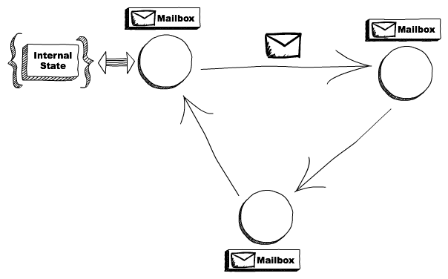
Actor Model – Intro (Mailboxes)
Notes:
It’s important to understand that, although multiple actors can run at the same time, an actor will process a given message sequentially. (no threading or concurrency issues!!)
This means that if you send 3 messages to the same actor, it will just execute one at a time.
To have these 3 messages being executed concurrently, you need to create 3 actors and send one message to each.
Messages are sent asynchronously to an actor, that needs to store them somewhere while it’s processing another message.
The mailbox is the place where these messages are stored.

Slide 6
Actor Model – Intro (What they can do)
Create more actors (implicit with virtual actors)
Send messages to other actors.
Do logic and change local state.
Notes:
With “virtual actors” would simple “create” by sending to address that does not exists yet.
Need more detail here – especially last point

Slide 7
Actor Model – Intro (Distribution)
Location independence
Achieved by infrastructure and configuration
Notes:
Another interesting aspect of the actor model is that it doesn’t matter if the actor that I’m sending a message to is running locally or in another node.
Think about it, if an actor is just this unit of code with a mailbox and an internal state, and it just respond to messages, who cares in which machine it’s actually running? As long as we can make the message get there we are fine. This allows us to create systems that leverage multiple computers and helps us to recover if one of them fail

Slide 8
Actor Model - Implementations
Erlang
Akka Tookit (Scala and Java)
Akka.Net
Azure Service Fabric
Azure Functions (Durable Entities)
Orleans
Notes:
Orleans not only option!! Mainly focused on concept here rather that prescribing Orleans!

Slide 9
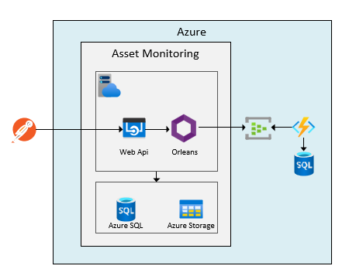
Experiment

Slide 10
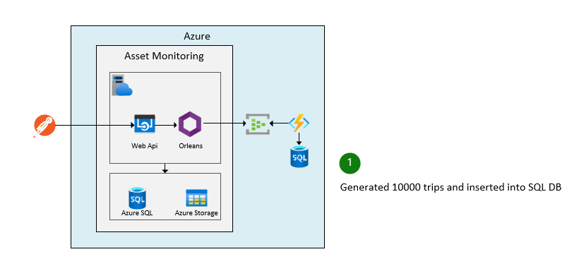
Experiment

Slide 11
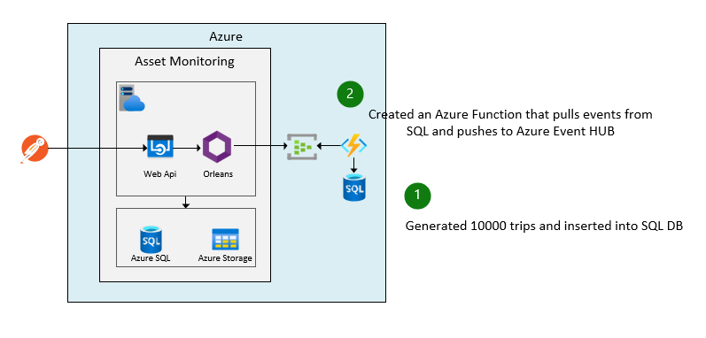
Experiment

Slide 12
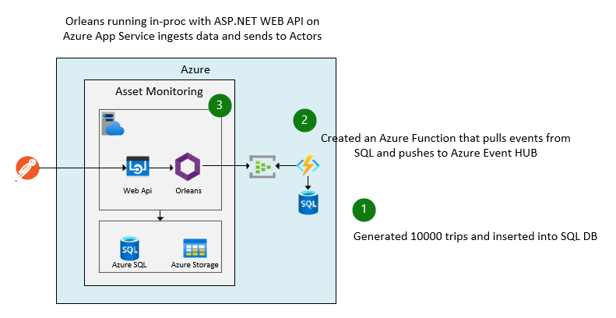
Experiment

Slide 13
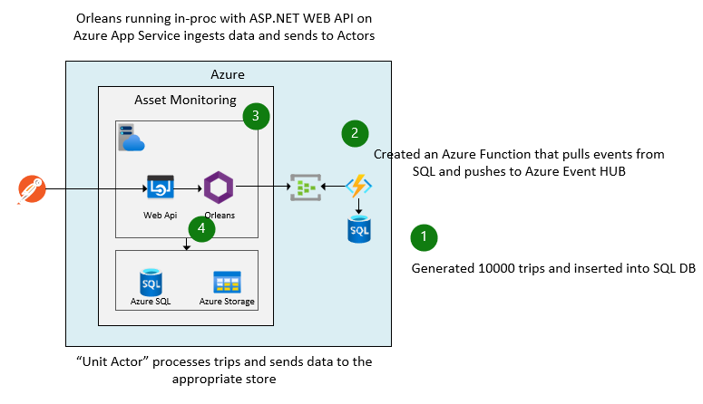
Experiment

Slide 14
Experiment

Slide 15
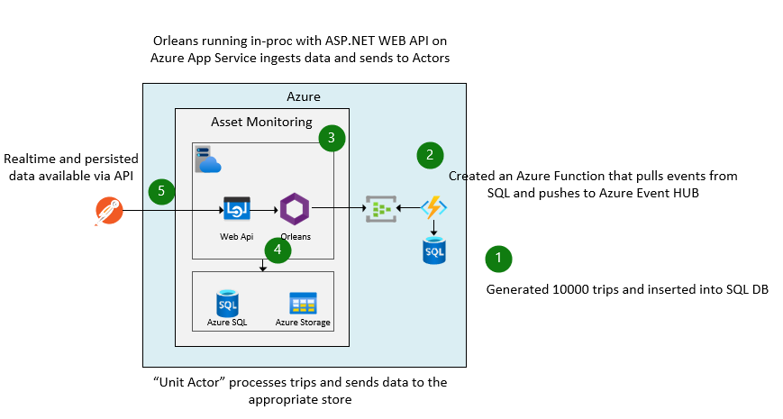
Experiment

Slide 16
DEMO
Notes:
Walk through Azure resources
Walk through solution
Allude to pluggability of Orleans and .Net in general I suppose (if we do it right)
Run Demo

Slide 17
Costs
Event Hub: $750 per PU / month (5-10 MB/s ingress and 10-20 MB/s egress for both AMQP or Kafka)
Storage
Hot: $0.0219 per GB/month
Cool: $0.0119 per GB/month
Archive: $0.00133 per GB/month
Azure SQL – Demo used minimal. Not storing events, so should be much less than current.
Azure App Service – I used single P2V3 @ 4542.79 ZAR/Month, but can host on anything and scale cluster

Slide 18
Scale
Azure Storage.
Up to 5 PiB/account, max 250 accounts per region per subscription.
Max 20 000 requests per second/account
Event Hubs:
Up to 16 PUs on Premium
Up to 120 MB/s
App Service:
Up and Out (30 servers)
But can host on AKS, Container Apps or VMs if we want
Azure SQL: you guys know this one better that me 🙂

Slide 19
Manageability
All PaaS services
Orleans is the only “funny” (e.g. need to understand how to upgrade with minimal downtime, manage silos etc.)
If provision storage per tenant,
moving blob data from hot->cold->archive can be policy driven.
Deletion of tenant data becomes simple.
Costing and quality attributes can be managed per tenant.

Slide 20
Reliability
Mostly 4 nines guarantees – so do need architect for various scenarios
Trade-off between real-time speed and potential data loss e.g. if cluster goes down and events not persisted.

